Slide 1
Virtual Screening of ACC Allosteric Inhibitor
Yao Chen
Dr.CG-Zhang
Dr.Yuan

Slide 2
ACC ( Acetyl Coenzyme A Carboxylase)
Mitochondria
Cytoplasma
Acetyl-CoA
ACC2
ACC1
FAO
(Fatty Acid Oxidation)
FANsy( Fatty Acid Synthesizing)
Malonyl-CoA
Fatty Acid Level
CPT-1
Obesity
Diabetes
Cancer

Slide 3
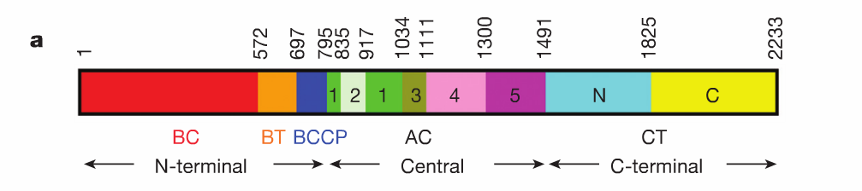
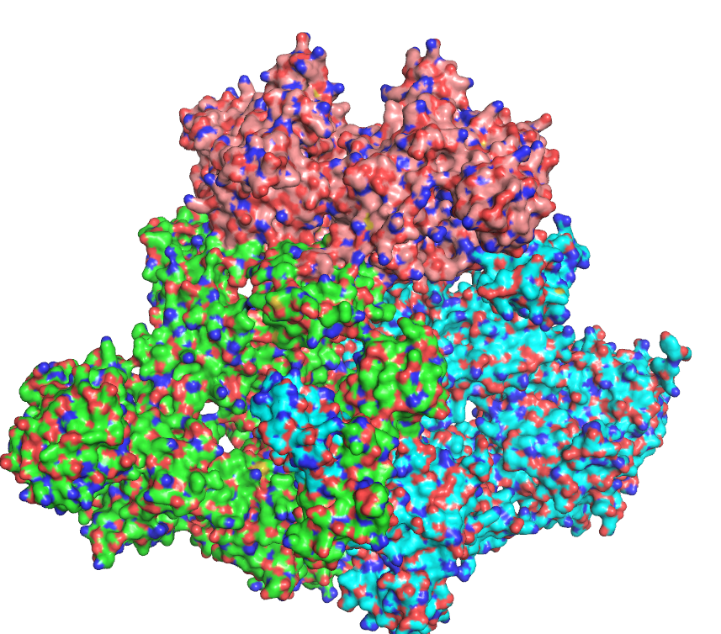
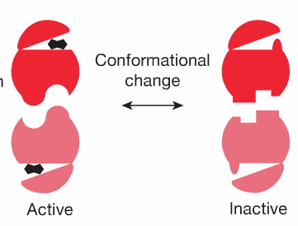
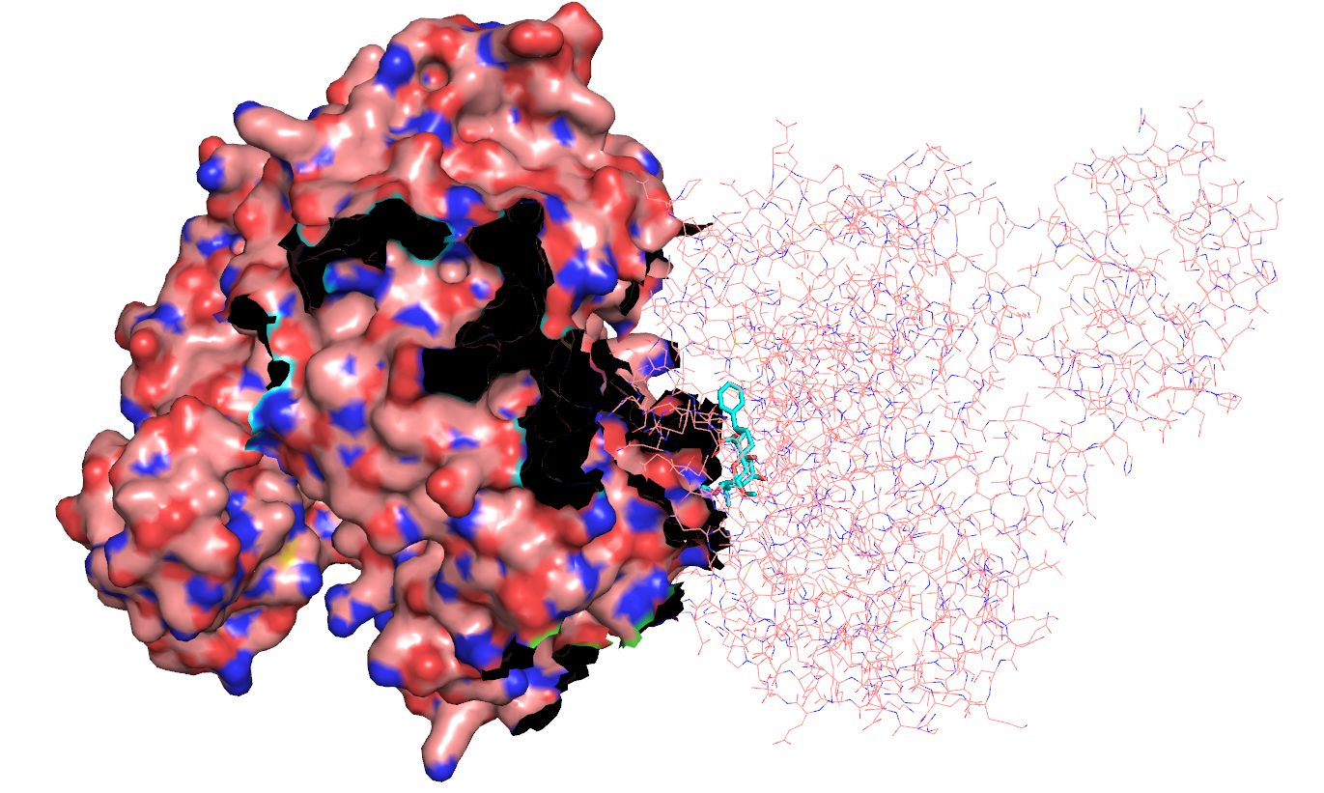
1.The Receptor Selection
BC Domain
Allosteric Binding Site
Allosteric Binding Site
BC Domain in ACC1 and ACC2
BC Domain In ACC1 and ACC2 has 84% Identity
ACC1 and ACC2 Allosteric binding site have 100% sequence Identity
Only ACC2 has the reported Inhibitor-Rceptor complex Crystal Structure

Slide 4
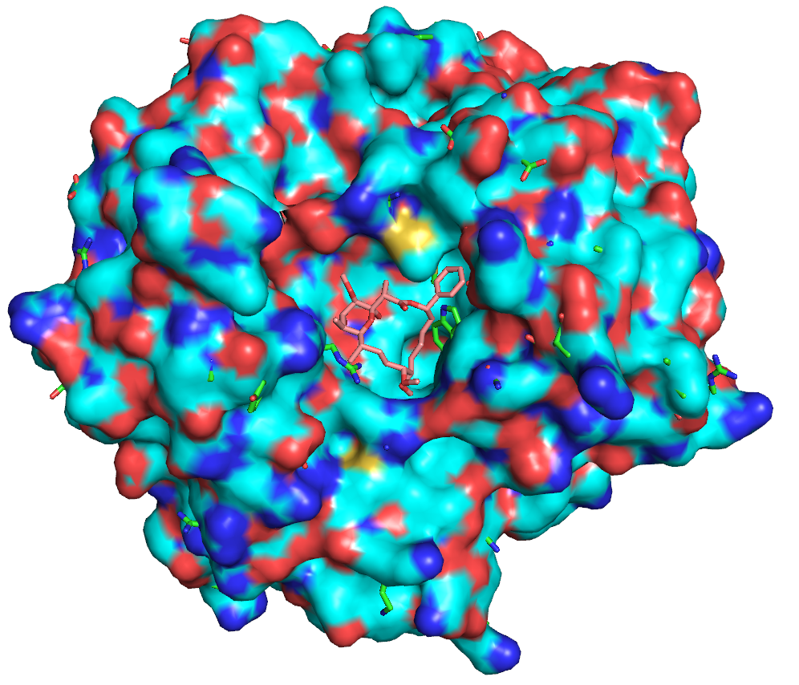
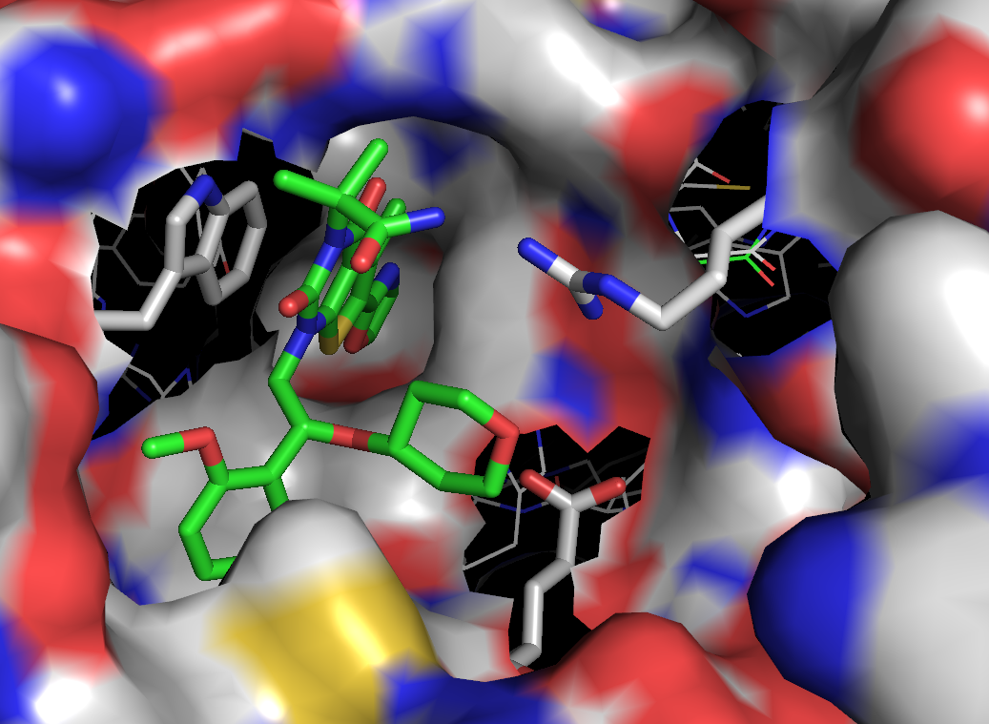
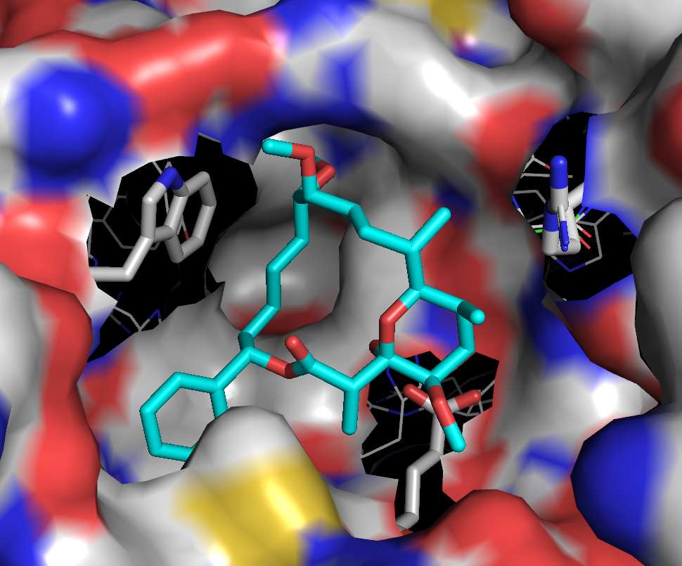
ACC1/ACC2 BC domain Comparison
ND-646
SarophenA
Pink: Inhibitor (SarophenA) From ACC2
Blue: ACC2 Surface ( Complex With Ligand)
Green: ACC1 Side Chain( Without Ligand)

Slide 5
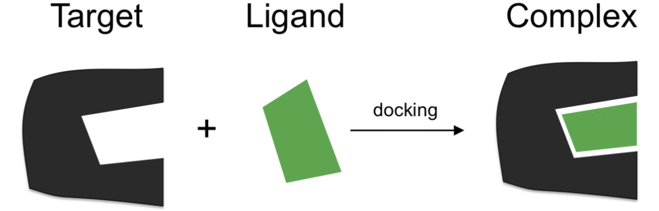
Virtual Screening
ZINC
SPECS
NCI
Large Compound Data Base
Millions of Compounds
Order Compounds
Evaluation
Score
Rank

Slide 6
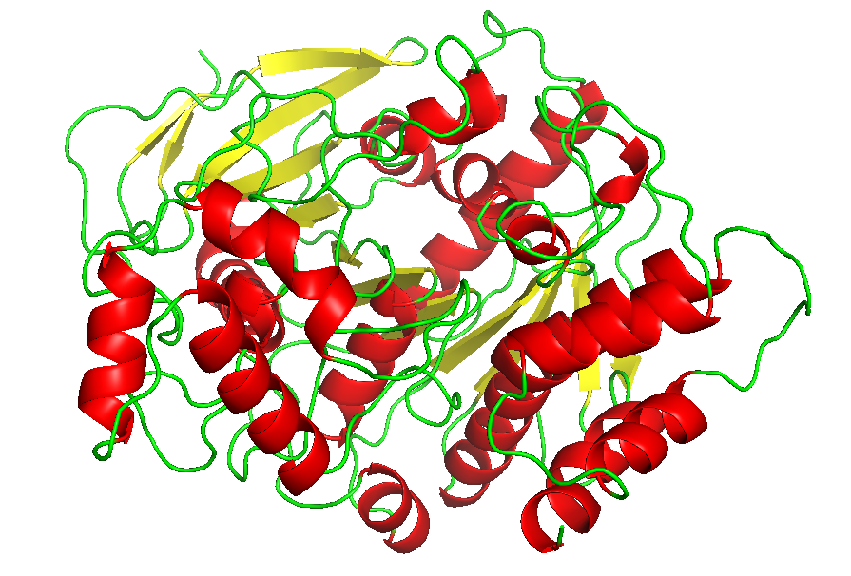
Docking Validation on BChE
Base Data Selection
Active Data Selection
Name | Type | uM | Source
5K5E_6QS | IC50 | 0.7634 | PDB
4XII_40V | IC50 | 0.215 | PDB
4TPK_3F9 | KI | 0.00271 | PDB
4BDS_THA | KI | 0.025 | PDB
44435223 | KI | 0.0035 | CID
46229144 | KI | 0.009 | CID
9928503 | KI | 0.02 | CID
44435219 | KI | 0.028 | CID
44435217 | KI | 0.088 | CID
1889619 | KI | 0.09 | CID
222149 | KI | 0.22 | CID
44435218 | KI | 0.47 | CID
607810 | KI | 0.6 | CID
44435201 | KI | 1.7 | CID
4244497 | KI | 4.69 | CID
893336 | KI | 6.2 | CID
705776 | KI | 7.1 | CID
2301676 | KI | 9.2 | CID
1991974 | KI | 20.5 | CID
1371037 | KI | 23 | CID
12851056 | KI | 24.7 | CID
17652420 | KI | 42.5 | CID
Mixed with 500 Random compounds from ZINC compound Database
BChE From 4TPK (Mus)

Slide 7
Enrichment Study (Docking after Vina)
10%
Number
5%
in 10% 100% Was Found
in 5% 89% Was Found
Score

Slide 8
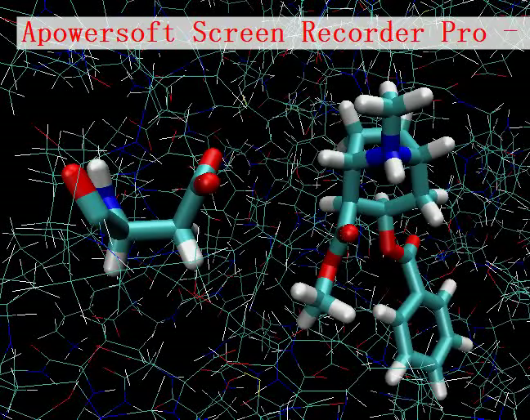
BEAR(Binding estimate after refinement) Method
Molecular Dynamic Optimization
Achieve the best binding poses
MM-PBSA( molecular mechanism Boltzmann ) binding free energy calculation
Accurate
Solvation Energy
∆G=$E_{electrical}$+$E_{vdW}$+$G_{polar}{+E}_{nonpolar}+{+E}_{solvation}−−TS$

Slide 9
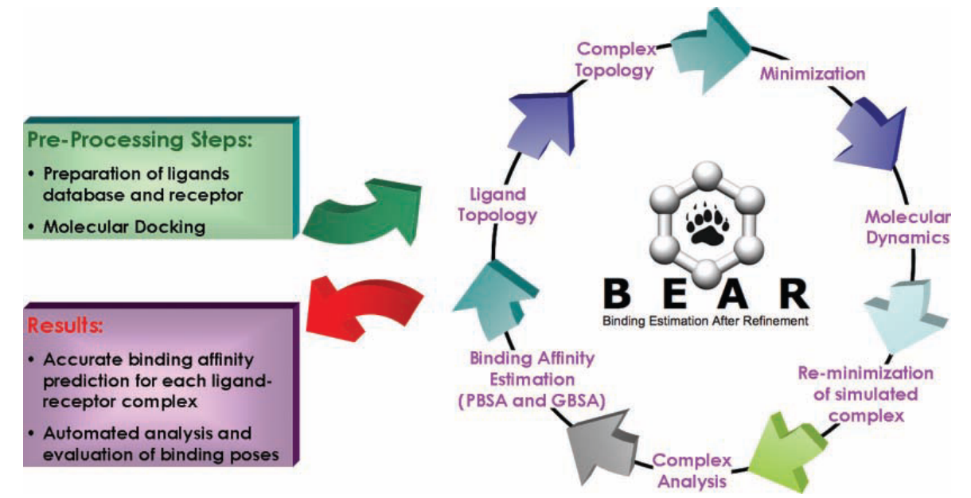
BEAR(Binding estimate after refinement) Method

Slide 10
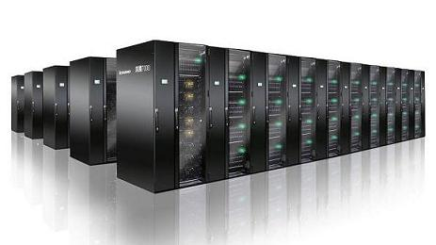
Steps of Screening
NCI
Time Consumption
250,000
Steps1
Step | Each | Total | Cores usage | Actual Time
1 | 30 s | 2000h | 300 | 18h
2 | 10min | 4000h | 300 | 32h
3 | 30min | 1200h | 20 | 60h
Docking
25,000
Steps 2
4,000
BEAR
Steps 3
(GPU Acceleration)
Implementation of High Performance Computing
1000
select 100
UK HPC cluster (DLX2/3)

Slide 11
3.Docking Result
Point of differentiating the Energy
Number
Number
ΔG(kcal)
Score
Number
ΔG(kcal)

Slide 12
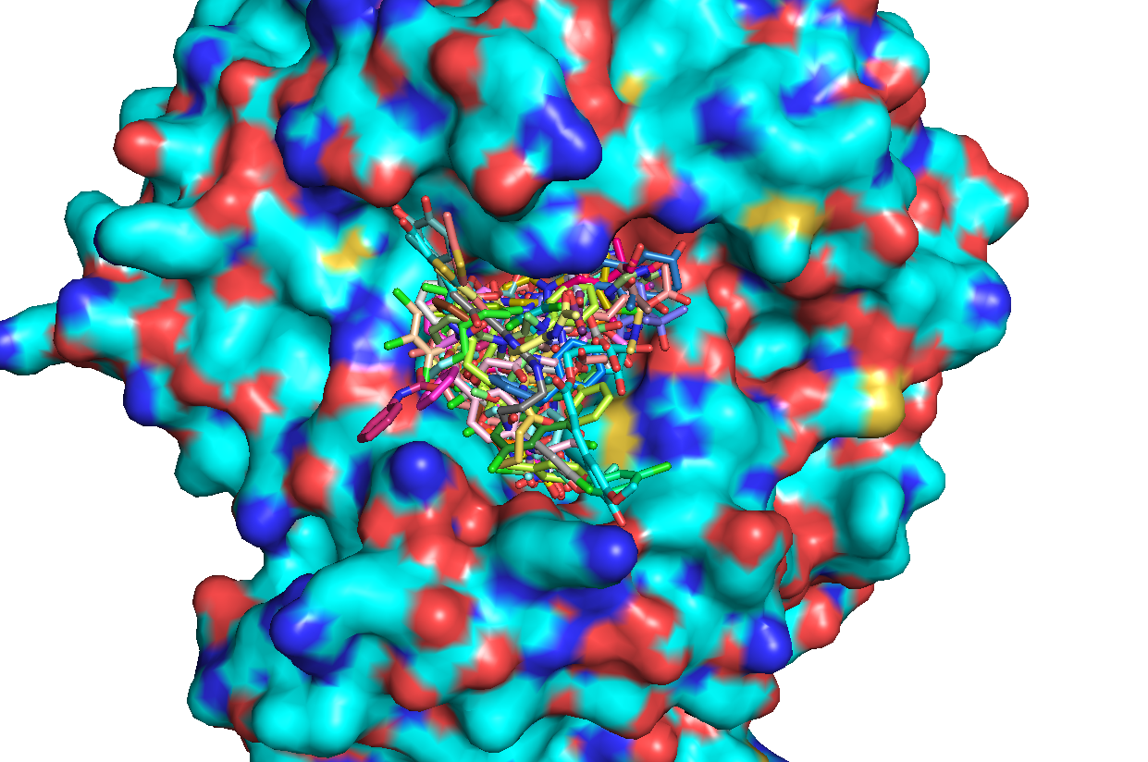

Slide 13
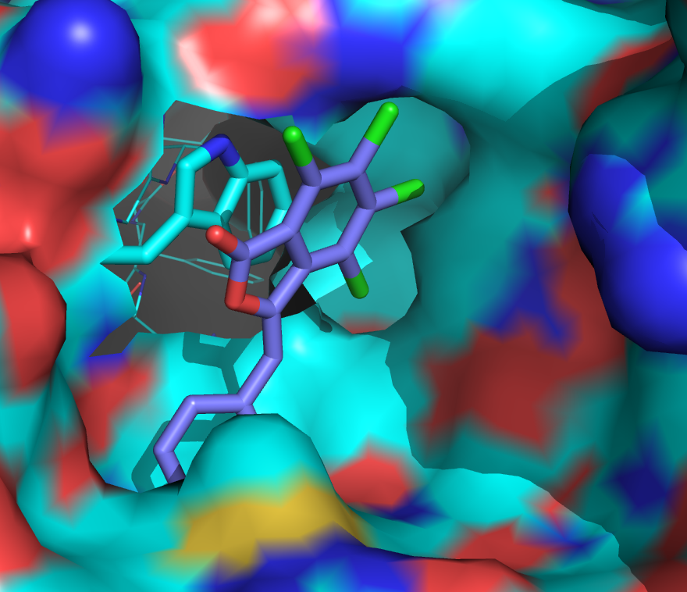
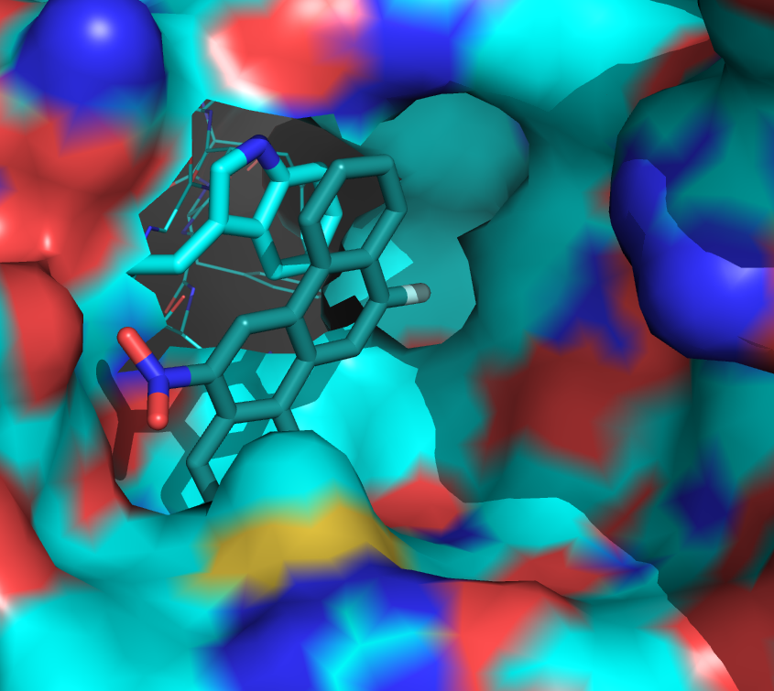
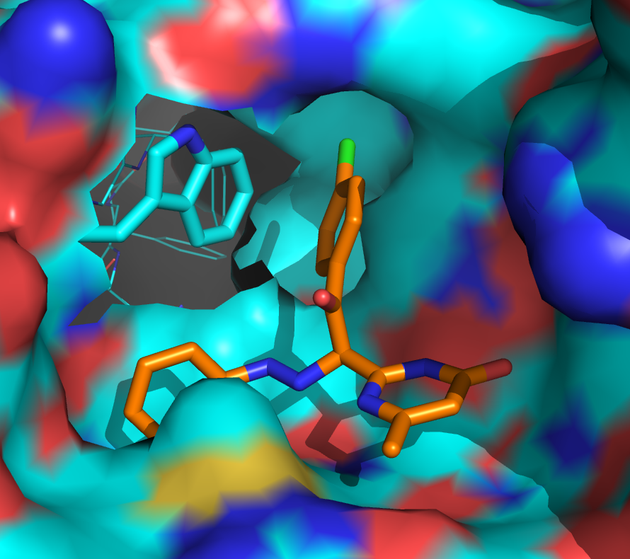
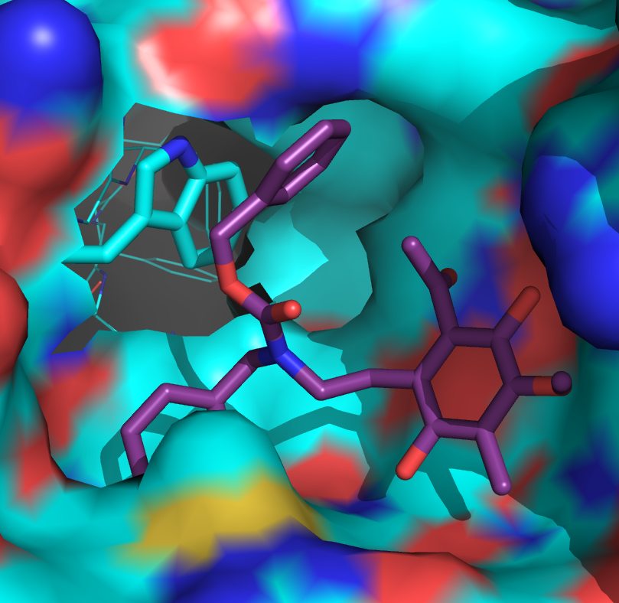
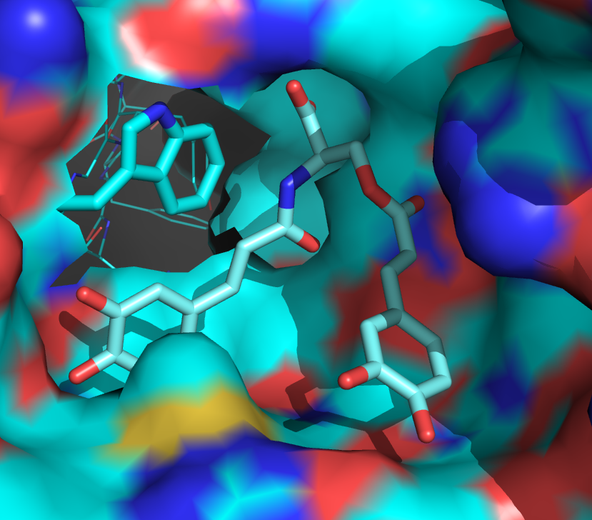
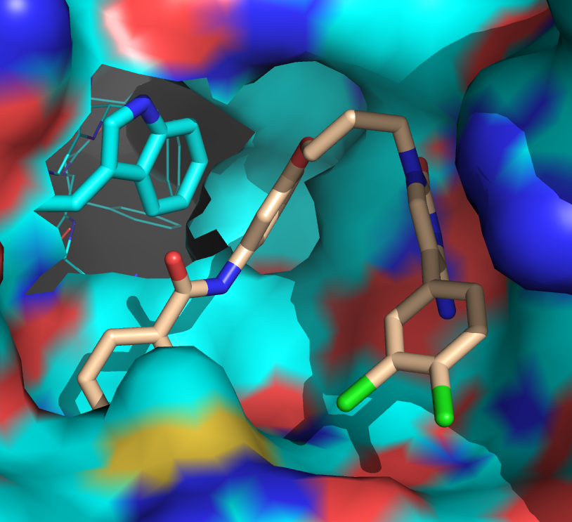
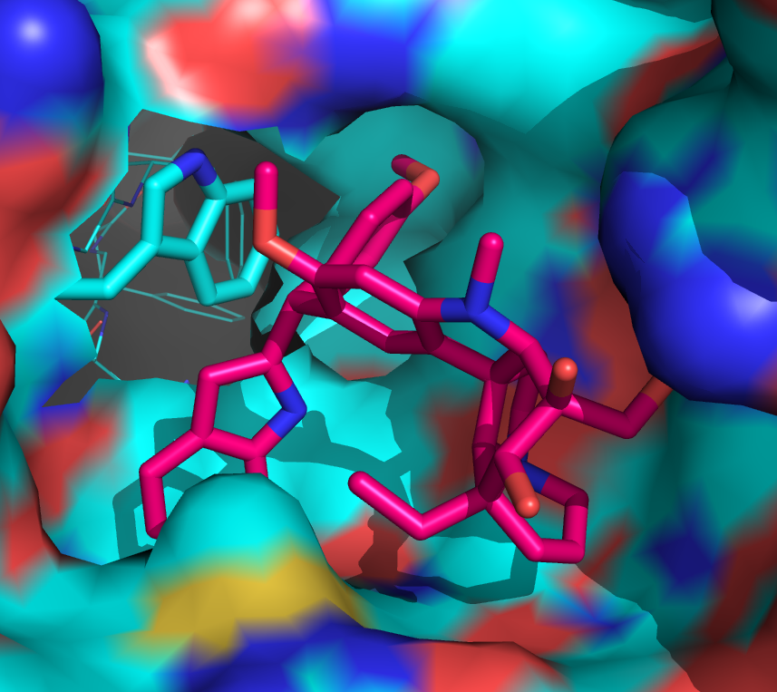
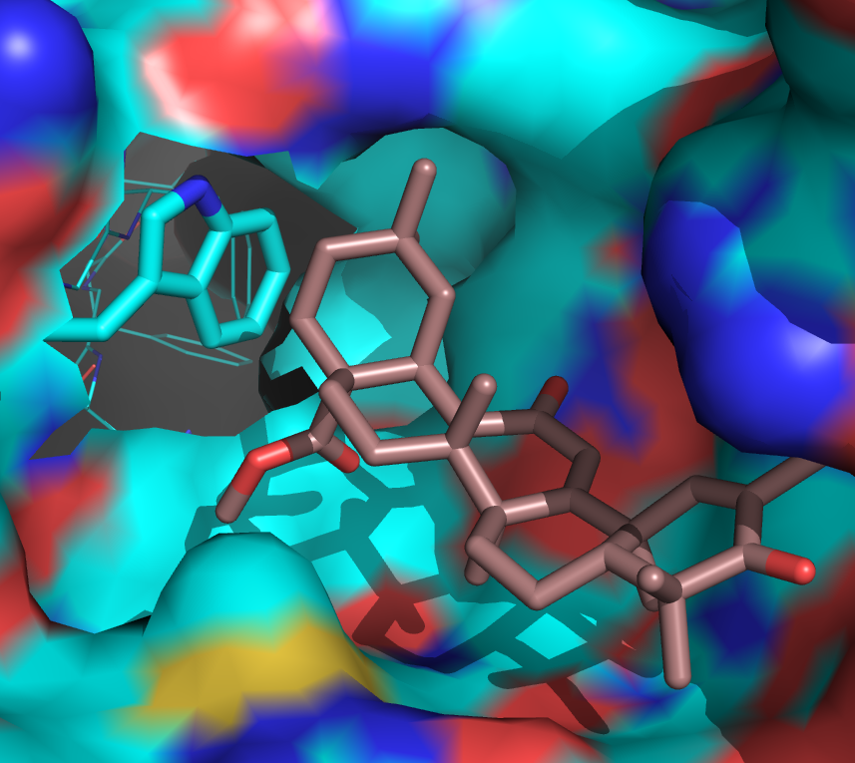
Result of Virtual Screening

Slide 14
Reference
Dahlin, J. L., et al. (2015). "PAINS in the assay: chemical mechanisms of assay interference and promiscuous enzymatic inhibition observed during a sulfhydryl-scavenging HTS." J Med Chem 58(5): 2091-2113.
J. W. Corbett, K. D. Freeman-Cook, R. Elliott, F. Vajdos, F. Rajamohan, D. Kohls, E. Marr, H. Zhang, L. Tong, M. Tu, S. Murdande, S. D. Doran, J. A. Houser, W. Song, C. J. Jones, S. B. Coffey, L. Buzon, M. L. Minich, K. J. Dirico, S. Tapley, R. K. McPherson, E. Sugarman, H. J. Harwood, Jr., W. Esler, Bioorg Med Chem Lett 2010, 20, 2383-2388.
G. Degliesposti, C. Portioli, M. D. Parenti, G. Rastelli, J Biomol Screen 2011, 16, 129-133.
A. M. Ferrari, G. Degliesposti, M. Sgobba, G. Rastelli, Bioorg Med Chem 2007, 15, 7865-7877.
G. Harriman, J. Greenwood, S. Bhat, X. Huang, R. Wang, D. Paul, L. Tong, A. K. Saha, W. F. Westlin, R. Kapeller, H. J. Harwood, Jr., Proc Natl Acad Sci U S A 2016, 113, E1796-1805.
M. A. Silvers, S. Pakhomova, D. B. Neau, W. C. Silvers, N. Anzalone, C. M. Taylor, G. L. Waldrop, Biochemistry 2016, 55, 4666-4674.
L. Tong, H. J. Harwood, Jr., J Cell Biochem 2006, 99, 1476-1488.
J. Wei, L. Tong, Nature 2015, 526, 723-727.
D. B. Jump, M. Torres-Gonzalez, L. K. Olson, Biochem Pharmacol 2011, 81, 649-660.

Slide 15
Question?

